Slide 1
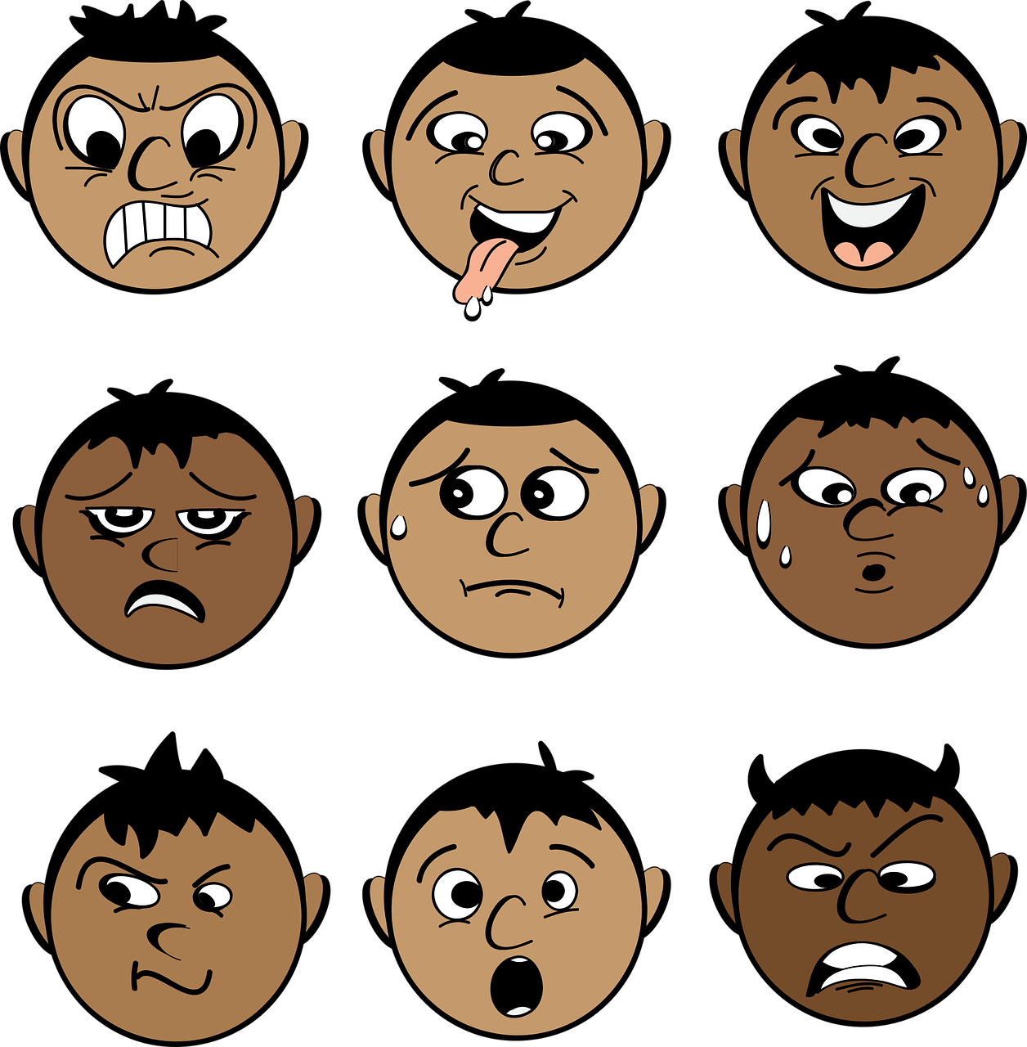
Facial emotion recognition in real-time and static images
MANIMARAN N
S7 D 31
CHN15CS070
Notes:
It is argued that to truly achieve effective human-computer intelligent interaction (HCII), there is a need for the computer to be able to interact naturally with the user, similar to the way human-human interaction takes place.

Slide 2
Inevitably feelings play an important role not only in our relations with other people but also in the way we use computers
As emotional state of a person may influence concentration, task solving and decision making skills, affective computing vision is to make systems able to recognize and influence human emotions in order to enhance productivity and effectiveness of working with computers.
Why ?
Notes:
Simple defenition only needed

Slide 3
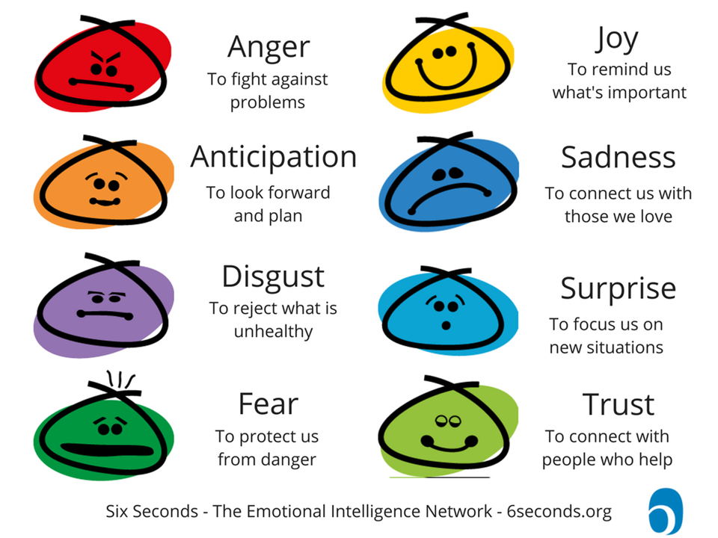
{ 0=neutral, 1=anger, 2=contempt, 3=disgust, 4=fear, 5=happy, 6=sadness, 7=surprise }
Notes:
icebreaker

Slide 4
Cohn-Kanade Database (CK)
Extended Cohn-Kanade Database (CK+)
Python
OpenCV
Dlib library
CMake
Boost-Python
FACS
HAAR
Support vector machine
MATERIALS AND DATASETS
Notes:
Simple defenition only needed

Slide 5


Where?
Static images
Real time

Slide 6
How ?
Data organization
Face detection
Feature extraction
Training & classification

Slide 7
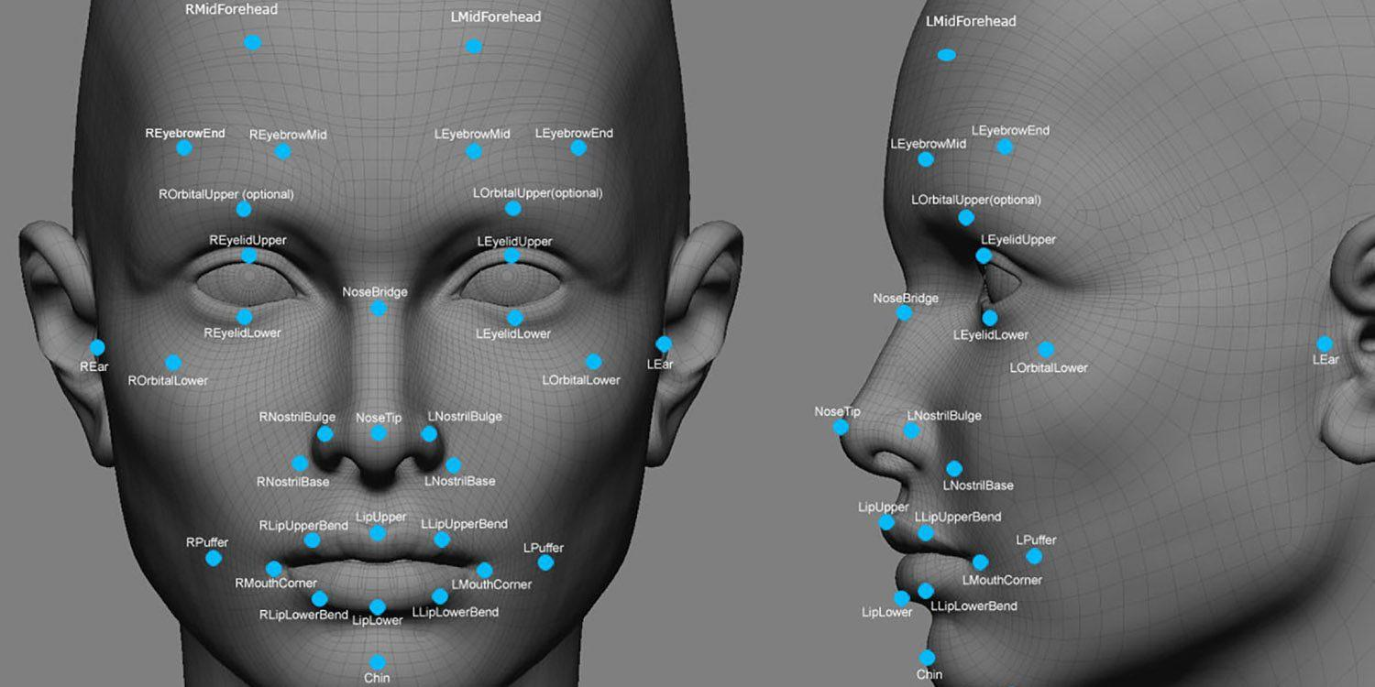
Facial Landmarks

Slide 8
Real time
Data organization
Face detection &
Landmark detection
Feature extraction
Training and classification

Slide 9
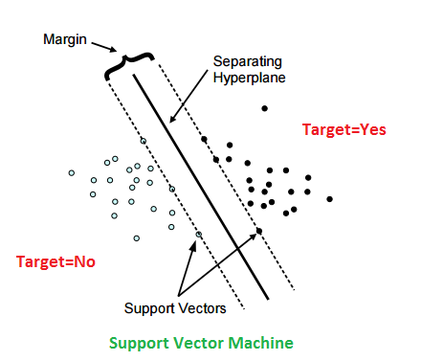
Support Vector Machine

Slide 10
PERFORMANCE EVALUATION

Slide 11
94%
Accuracy rate
Using S V M Classification

Slide 12
94.1%
91.2%
Linear S V M
Polynomial S V M
88.7%
88.1%
K-Means Clustering
Random Classifer

Slide 13
Emotions | Happy | Sad | Fear | Angry | Contempt | Disgust | Surprise | Neutral | Accuracy
Happy | 95 | 0 | 0 | 3 | 1 | 0 | 0 | 1 | 95%
Sad | 1 | 85 | 2 | 0 | 3 | 0 | 1 | 0 | 92.3%
Fear | 2 | 2 | 82 | 0 | 0 | 4 | 0 | 0 | 91%
Angry | 2 | 1 | 3 | 78 | 0 | 3 | 0 | 0 | 89.6%
Contempt | 0 | 2 | 1 | 3 | 64 | 0 | 3 | 0 | 87.7%
Disgust | 1 | 3 | 2 | 0 | 0 | 84 | 0 | 1 | 92.3%
Surprise | 2 | 0 | 2 | 0 | 2 | 1 | 91 | 0 | 92.9%
Neutral | 0 | 2 | 1 | 1 | 0 | 0 | 1 | 81 | 91.2%
Overall Accuracy = (660/717 *100%) = 92.1%

Slide 14
Applications
Software engineering
Education and e-education
Emotional stereotypes of learners
Enhanced websites customization
Video Games
Notes:
Software engineering:
First Impression test
Task-based usability test
Free interaction test
Comparative test
Development process improvement
IDE usability comparison
Productivity and emotions
Tele and office working comparison
4 Education and e-education

Slide 15
CONCLUSION

Slide 16
Thank You

